Slide 1
Data Science Certification Capstone
Atlanta Suburb Town Center Study
focus on food venue type and quantity
John E. Sivak
February 21, 2020

Slide 2
Introduction
The Atlanta, Georgia area has had huge success in the development of suburb downtown centers. Many suburbs have developed the downtown centers with a variety of retailers. For this project, we will evaluate the types and numbers of restaurants within walking distance from the downtown centers. We will be able to establish which restaurant types are most common and which restaurants may be lacking within the individual suburb town centers.
By analyzing this data, we can provide recommendations where there may be growth opportunities for establishing new restaurants within each suburb town center. We will also be able to conclude which types of restaurants are key to making the most popular town centers a success. Our analysis will also allow us to evaluate whether the official GPS location of a town center is the true center of the successful retail experience.
Developers and investors will be able to assess what types of restaurants and locations are best for potential business opportunities.
Our evaluation will start with the following suburbs of Atlanta, GA:
Dunwoody, Sandy Springs, Roswell, Woodstock, Norcross, Suwanee, Alpharetta, Marietta, Duluth

Slide 3
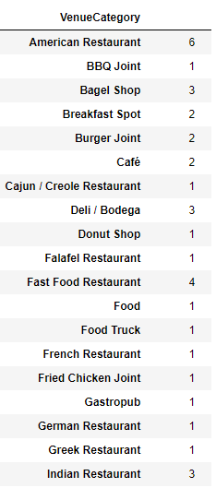
Data
Foursquare was used to explore the various suburb town centers around Atlanta, GA. We have chosen only restaurant type for this analysis in the hope that we will have a statistically significant amount of data for each suburb in the study.
A sample set of data from Foursquare is showing the types and number of restaurants in the Alpharetta suburb:

Slide 4
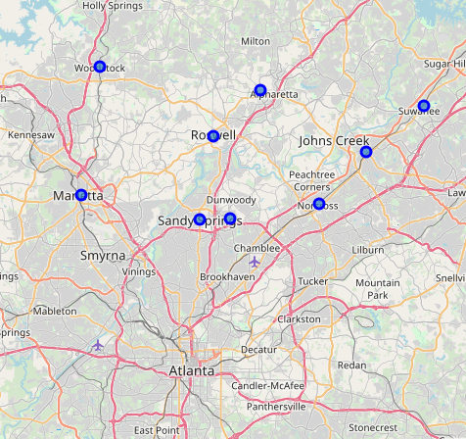
Data- Town Centers
We will be identifying each town center’s GPS location and then evaluate the restaurants within 2000m of the known town center. 2000m should capture the restaurants within walking distance of the town centers. Googles Geocoding API will be used for identifying the established latitude and longitude of each town center.
The town centers for the initial selection of towns are illustrated

Slide 5
Methodology
The most popular town centers north of Atlanta were chosen for the study. Our goal was to plot the known town center GPS coordinates and then plot the food venues within a certain radius.
We then evaluated the type and number of food venues to determine how many of each were in each suburb and also type of numbers of venues in all the suburbs combined.
We decided to combine all the venues from all suburbs to get a larger statistically significant number of venues for the study.
Our assumption was that each town center was equally successful and that by evaluating them as a whole, we would achieve better results.
We did 3 iterations of varying distances from the town center to see if it made a difference in the type of venue the further you went from the town center. We used 1000 meters, 2000 meters, and 3000 meters.
In order to illustrate the results, we created 3 word clouds, 1 for evaluation of varying distances from the town center.

Slide 6
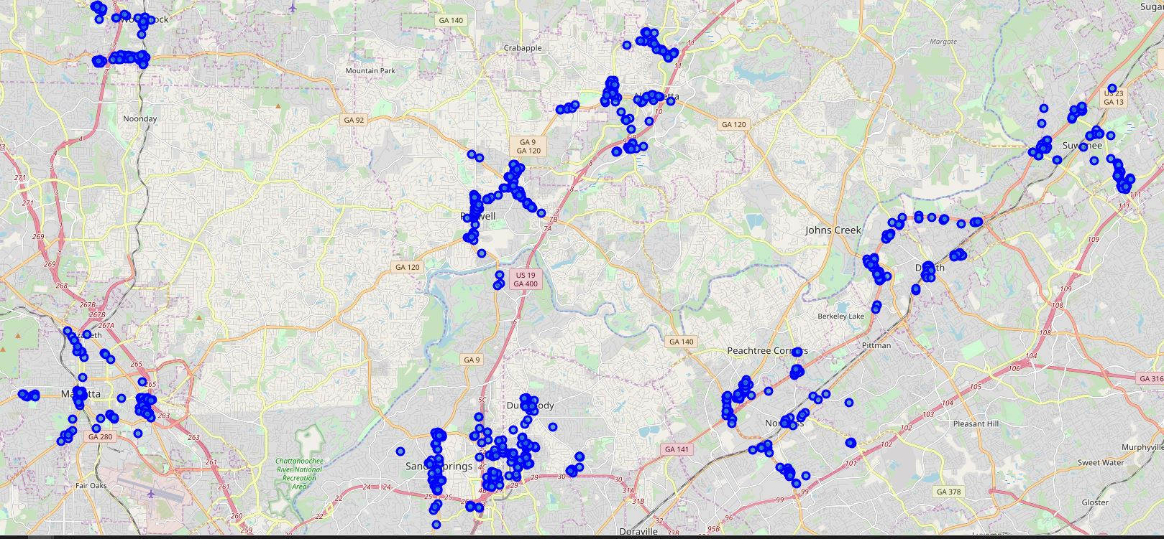
Results and Analysis
We plotted the various food venues on 3 different maps to demonstrate where the venues are in each of the suburbs.
Below is an example of the venues at 2000 meters from town center
At 2000 meters from town center, we discovered that there are 73 unique food categories represented. These food categories will be used in creating the Word Clouds.

Slide 7
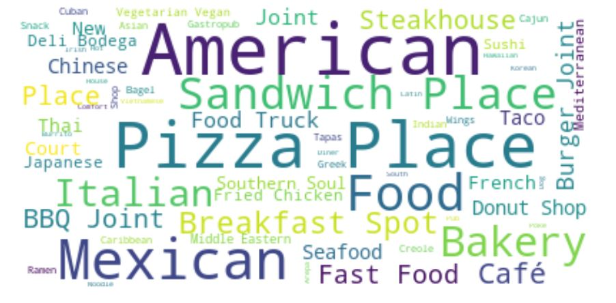
Analysis at 1000 meters
Our initial study at 1000 meters from town centers, we found that the most common venues were American, Pizza and Mexican. We took note that Fast Food was noticeably small in comparison to the other venues

Slide 8
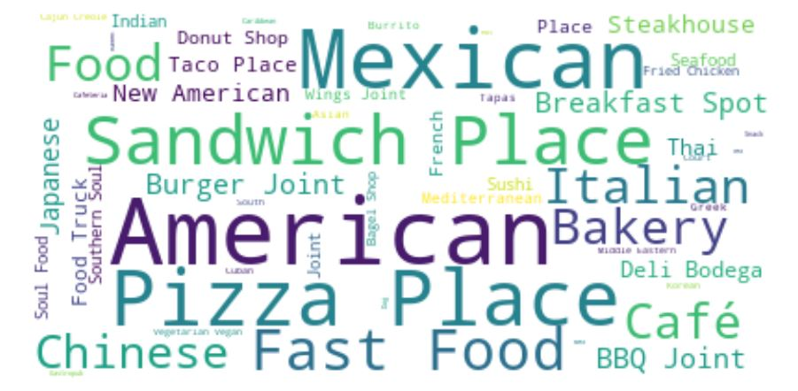
Analysis at 2000 meters
At 2000 meters from the town centers, we observed that American, Pizza and Mexican again were at the top of the list. However, we noticed that Fast Food was now larger, signifying an increase in the number of Fast Food restaurant the farther you go from town centers.

Slide 9
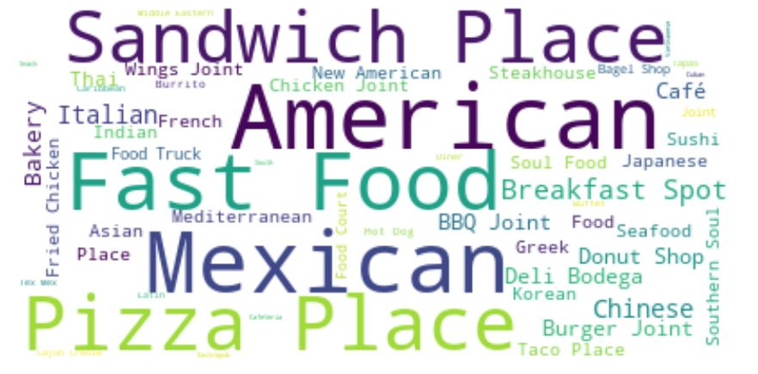
Analysis at 3000 meters
At 3000 meters from the town centers, we again observed American, Pizza and Mexican at the top of the list, but this time we now see Fast Food and Sandwiches are almost the same level as the top 3. Again, this is demonstrating the increase of Fast Food restaurants the further you go from town centers.

Slide 10
Conclusion
The town centers of Dunwoody, Sandy Springs, Roswell, Woodstock, Norcross, Suwanee, Alpharetta, Marietta, Duluth are well recognized as models of success for great businesses, especially in food retail. By evaluating what type of restaurants are most popular in these town centers, we can predict which types of food venues will succeed in future town center development. Each one of the town centers has its own uniqueness and by combining the venues from all of the towns, we can have more confidence in the results.
We can conclude from our study that as you go further from town center, you will see more Fast Food restaurants. This most likely implies that Fast Food may not be appropriate for close proximity to town centers. This aligns with the mom & pop type shops that are normally in these successful town centers.
We can also conclude that American, Mexican and Pizza can be a success regardless of distance to the town center.
Of the remaining food venue types, especially at 1000 meters, we can conclude that there are dozens of other venues that can be successful within walking distance of the town centers.

Slide 11
Future Direction
It would be helpful to dig deeper into this data for more insights and to evaluate each town center separately. It would also be helpful to incorporate other data sources to validate the Foursquare data such as Yelp and Trip Advisor.
Developers and investors can derive great value in using this data to support their decisions in choosing a food venue type and location.

